Slide 1
Secure Computation and
Low-Complexity Cryptography
Yuval Ishai
Technion and AWS
Low-Complexity Cryptography Workshop
Rome, May 9, 2026

Slide 2


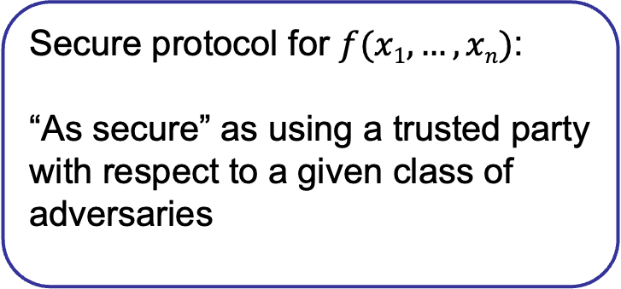
Secure Computation
computing on sensitive data without introducing a single point of failure
x₄
Secure protocol for $f(x1,…,xn)$:
“As secure” as using a trusted party
with respect to a given class of adversaries
x₃
x₅
x₂
x₆
x₁
Notes:
2
Want to replace by a decentralized alternative

Slide 3

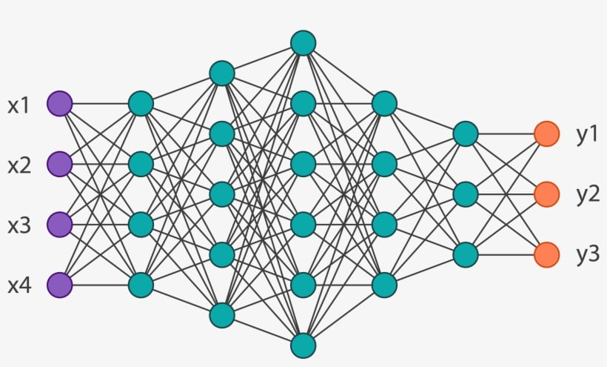

Example: Secure Computation for AI
Patient
Biotech Company
Secure
Classification
Notes:
3
Server holding some proprietary model, say detecting a rare medical condition, and the client. They could both use a trusted third party, but this is a single point of failure.Secure computation allows the parties to compute without trusting each other or any other third party.

Slide 4
Wasn’t it all solved in the 1980s?
In a sense: YES!
Information-theoretic security possible with an honest majority (unconditionally)
[BenOr-Goldwasser-Wigderson 88, Chaum-Crépeau-Damgård 88, Rabin-BenOr 89]
Computational security possible even with dishonest majority (under standard assumptions)
[Yao 86, Goldreich-Micali-Wigderson 87]
Notes:
Recently recognized by STOC ToT award
Feasibility: New theorem statement saying Assumption X implies primitive Y, where Y involves some restricted interaction.
Asymptotic efficiency: new theorem statements X => asymptotic efficiency Y, where Y is new even with unrestricted interaction.
Concrete efficiency: outperform competing approaches even if we ignore assumptions and interaction. Even heuristics.

Slide 5
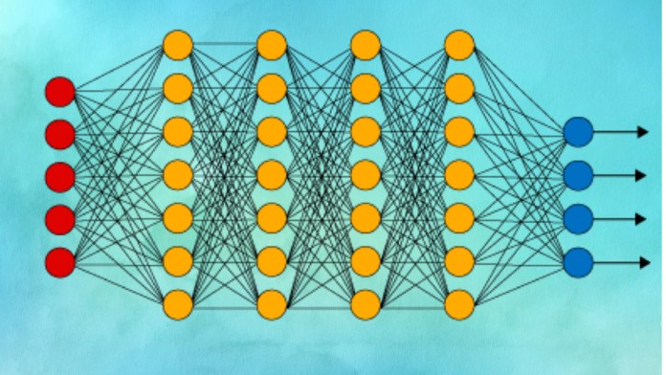
Wasn’t it all solved in the 1980s?
Major challenge: efficiency
  Communication
  Computation
  Rounds
  Which assumptions?
  Asymptotic vs. concrete
Surprisingly good match between theory and practice...
Notes:
Match between theory and practice: to a large extent because even if you are extremely pragmatic about assumptions, it is not known to help get more practical solution. In other words, we have small gaps between the provable solutions and the best heuristic “not broken” solution.
Feasibility: New theorem statement saying Assumption X implies primitive Y, where Y involves some restricted interaction.
Asymptotic efficiency: new theorem statements X => asymptotic efficiency Y, where Y is new even with unrestricted interaction.
Concrete efficiency: outperform competing approaches even if we ignore assumptions and interaction. Even heuristics.

Slide 6


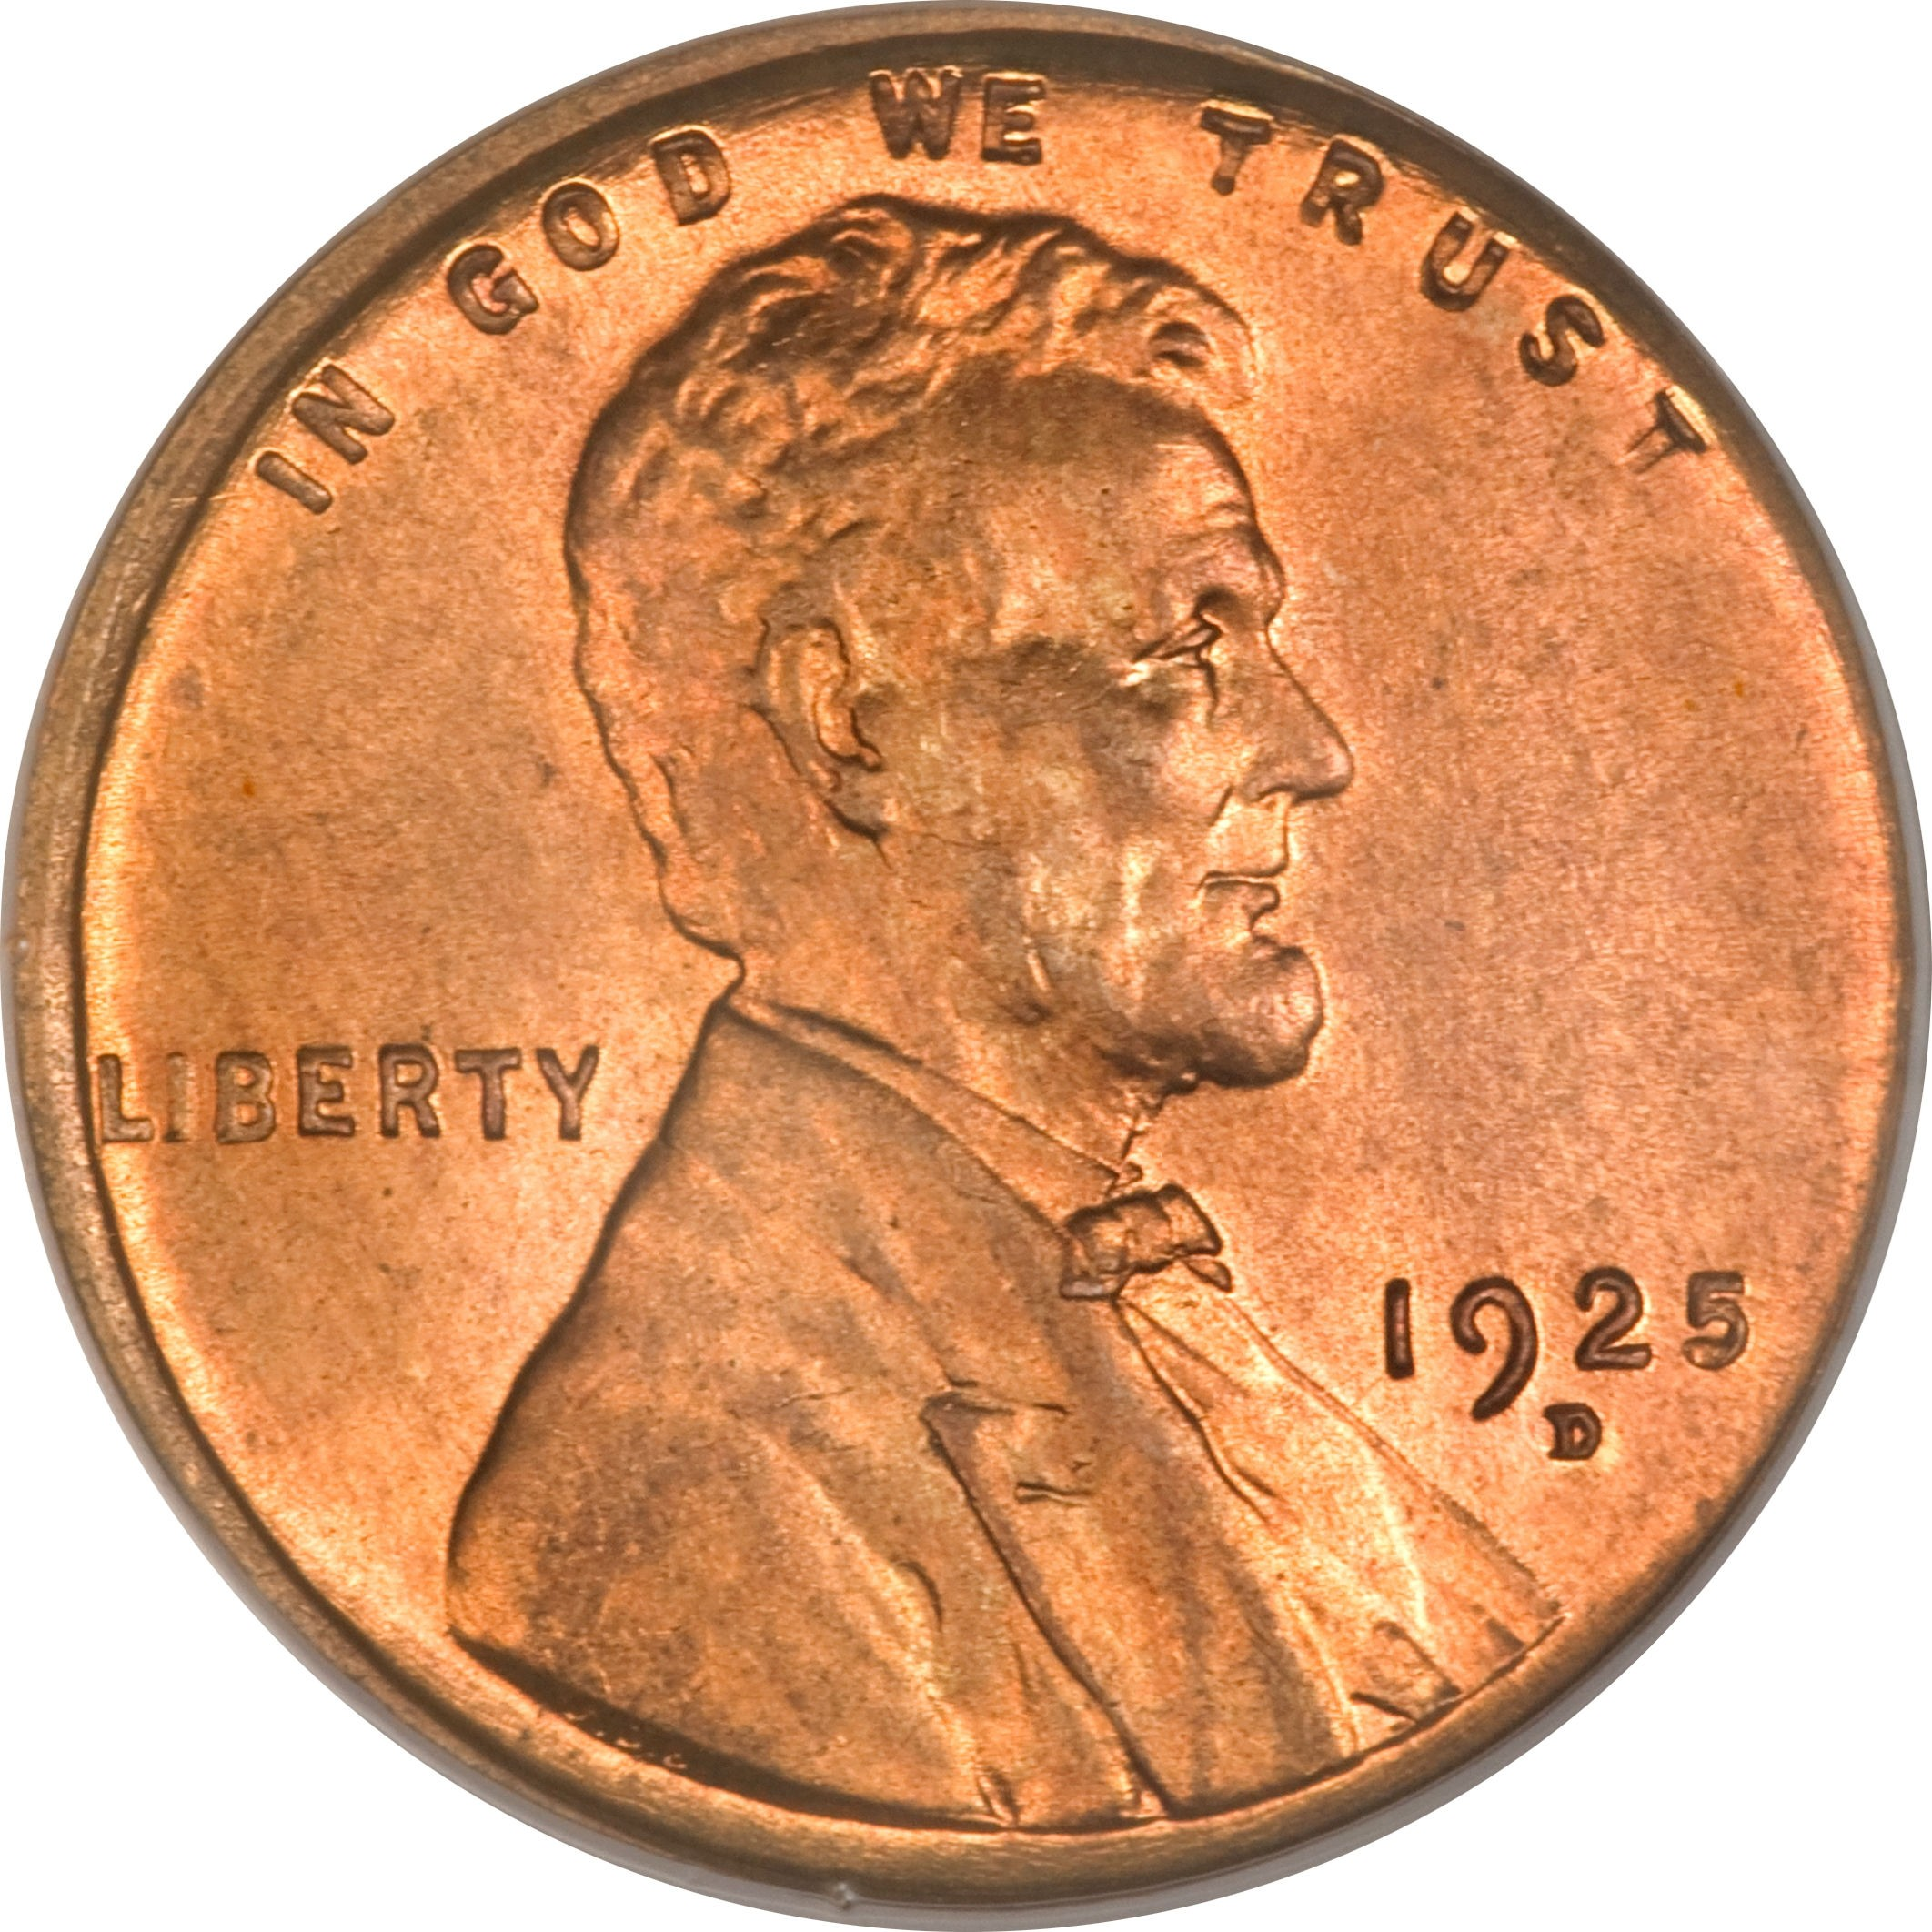
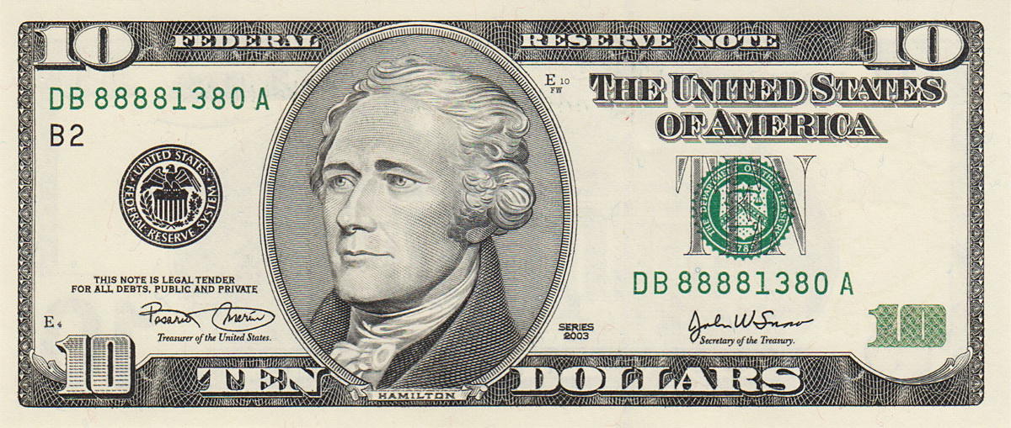
Rest of Talk: The Price of Security
Without security
Focus on simplest questions
Small number of parties, 2 by default
Semi-honest parties by default
Optimize one (simple) metric at a time
With security
What about assumptions?
Standard and minimal if possible
Explore new assumptions when needed
Goal: Minimize overhead
Notes:
Minimal assumptions – information theoretic security if possible

Slide 7
Rest of Talk: The Price of Security
Focus on simplest questions
Small number of parties, 2 by default
Semi-honest parties by default
Optimize one (simple) metric at a time
Broader questions about
low-complexity cryptography
What about assumptions?
Standard and minimal if possible
Explore new assumptions when needed
Notes:
Minimal assumptions – information theoretic security if possible

Slide 8
2PC Techniques
2 parties evaluate a Boolean circuit C, computational security against one semi-honest party
Garbled Circuits
[Yao 86,…]
Linear Secret Sharing
[Goldreich-Micali-Wigderson 87, …]
Communication >> |C|
“Lightweight crypto”
🙁
OT
OT
OT
OT
oblivious
transfer
😀
OT
OT
OT
OT
OT
OT
OT
OT
Fully Homomorphic Encryption
[Gentry 09,…]
Homomorphic Secret Sharing
[Boyle-Gilboa-I 15,…]
Communication << |C|
“Heavy crypto”
😎
Eval_{f}
Share
x₁
y₁
Eval_{f}
😢
x
Enc
Dec
x
x
f(x)
f(x)
+
f(x)
pk
sk
x₂
Eval_{f}
y₂

Slide 9
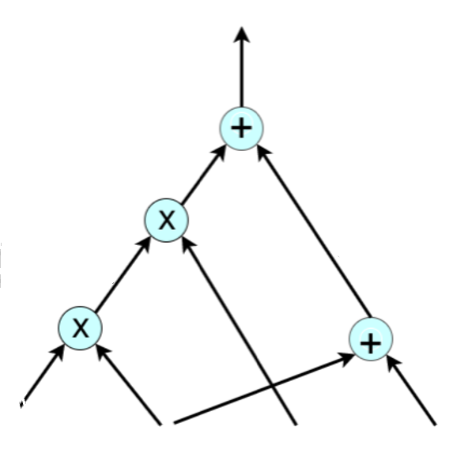
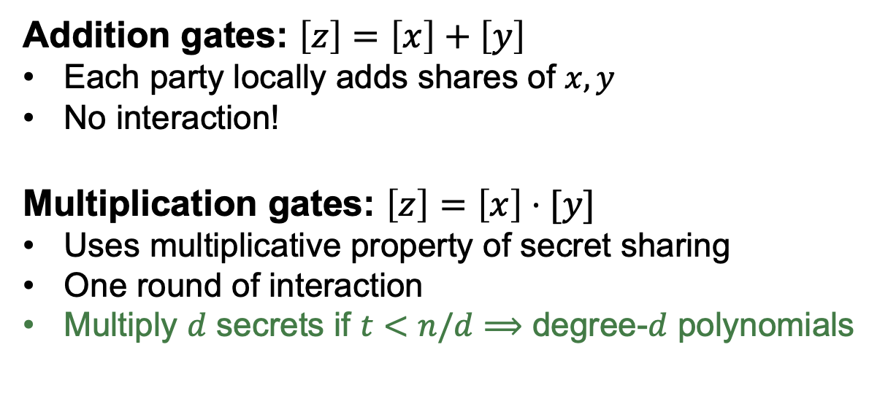




Honest-Majority MPC
n parties evaluate an arithmetic circuit C, perfect security against t<n/2 semi-honest parties
Addition gates: $\left[z\right]=\left[x\right]+\left[y\right]$
Each party locally adds shares of $x,y$
No interaction!
Multiplication gates: $\left[z\right]=\left[x\right]⋅[y]$
Uses multiplicative property of secret sharing
One round of interaction
Multiply $d$ secrets if $t<n/d$ $⟹$ degree-$d$ polynomials
$$f\left(x\right)$$
share $y_{i}$
Shamir’s scheme
secret $s$
$$i$$

Slide 10
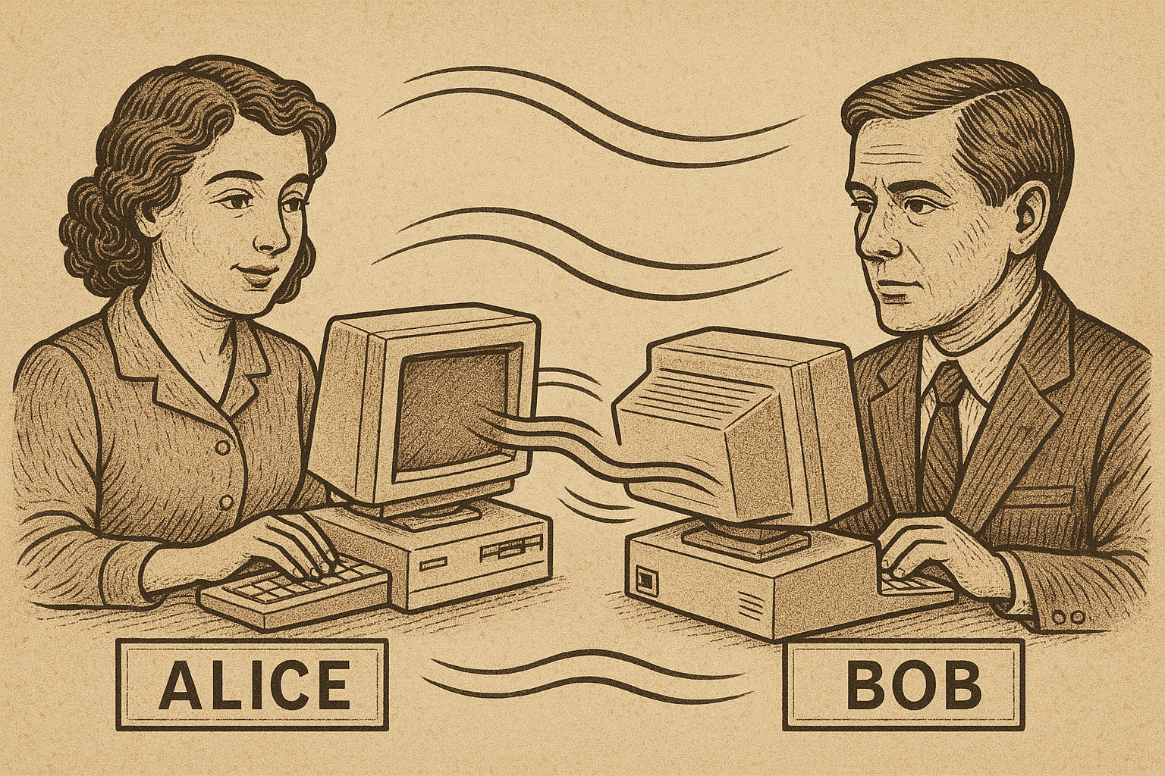
Minimizing Computation
Notes:
10

Slide 11

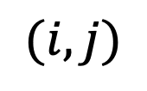



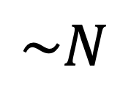
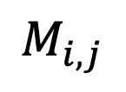
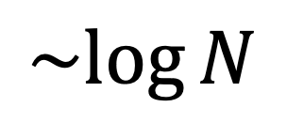

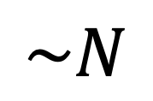
Which Metric?
$$M$$
$$M$$
MUX
Mod 2
Mult.
$$(i,j)$$
$$M_{i,j}$$
$$v$$
$$Mv$$
#entries in $M$
RAM time
$$\sim log{N}$$
$$\sim N$$
Circuit size
$$\sim N$$
$$\sim N$$
Notes:
Our key idea is to replace the cryptographic function f with a related function g, taking the original input of f and an additional random input, such that the output of g on input x and a uniformly random r is a randomized encoding of f(x). More specifically, we require that given g(x,r) one can decond f(x), and given f(x) one can simulate the distriution g(x,r) even without knowing x. We refer to g as a randomized encoding of f.
To be useful in our context this type of encoding should be on one hand secure, in the sense that, … and on the other hand liberal enough…
Note that if g is much easier than f, then moving from g to f must be complex.
We now define our notion of randomized encoding in more detail.

Slide 12
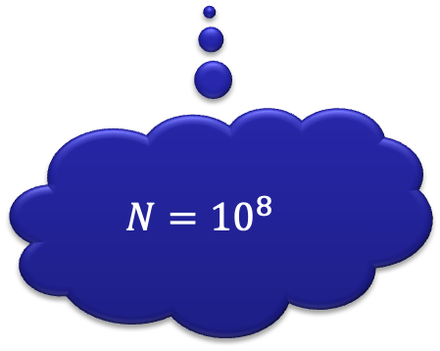
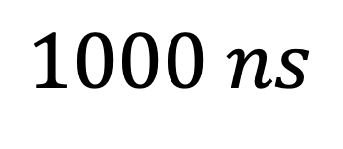
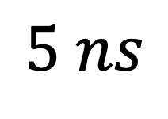
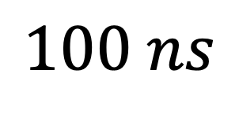
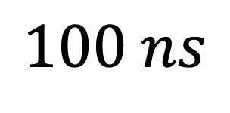
Which Metric?
$$M$$
$$M$$
MUX
Mod 2
Mult.
$$(i,j)$$
$$M_{i,j}$$
$$v$$
$$Mv$$
$$N={10}^{8}$$
CPU time
$$5 ns$$
$$1000 ns$$
GPU time
$$100 ns$$
$$100 ns$$
Notes:
Our key idea is to replace the cryptographic function f with a related function g, taking the original input of f and an additional random input, such that the output of g on input x and a uniformly random r is a randomized encoding of f(x). More specifically, we require that given g(x,r) one can decond f(x), and given f(x) one can simulate the distriution g(x,r) even without knowing x. We refer to g as a randomized encoding of f.
To be useful in our context this type of encoding should be on one hand secure, in the sense that, … and on the other hand liberal enough…
Note that if g is much easier than f, then moving from g to f must be complex.
We now define our notion of randomized encoding in more detail.

Slide 13
This Talk: Cost = Circuit Size
Boolean circuit, fan-in 2 gates
Computational Overhead =
Secure cost / Insecure cost
… for sufficiently large instances
Notes:
Our key idea is to replace the cryptographic function f with a related function g, taking the original input of f and an additional random input, such that the output of g on input x and a uniformly random r is a randomized encoding of f(x). More specifically, we require that given g(x,r) one can decond f(x), and given f(x) one can simulate the distriution g(x,r) even without knowing x. We refer to g as a randomized encoding of f.
To be useful in our context this type of encoding should be on one hand secure, in the sense that, … and on the other hand liberal enough…
Note that if g is much easier than f, then moving from g to f must be complex.
We now define our notion of randomized encoding in more detail.

Slide 14

Current Asymptotic Landscape
$λ$ bits of security, under plausible assumptions
1
O(1)
polylog($λ$)
EMVP [BCHIKMRR25]
OWF [Gol00]
FHE, PIR [GHS12,…]
ENC [AIK06,IKOS08]
SNARGs [HR22]
PRF [IKOS08,FLY22]
ZK, mal-2PC [DIK10]
CRH [AHIKV17]
semi-honest-2PC [IKOS08]
mal-OT [BCGIKRS23]
Notes:
14

Slide 15

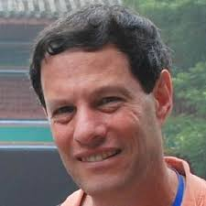
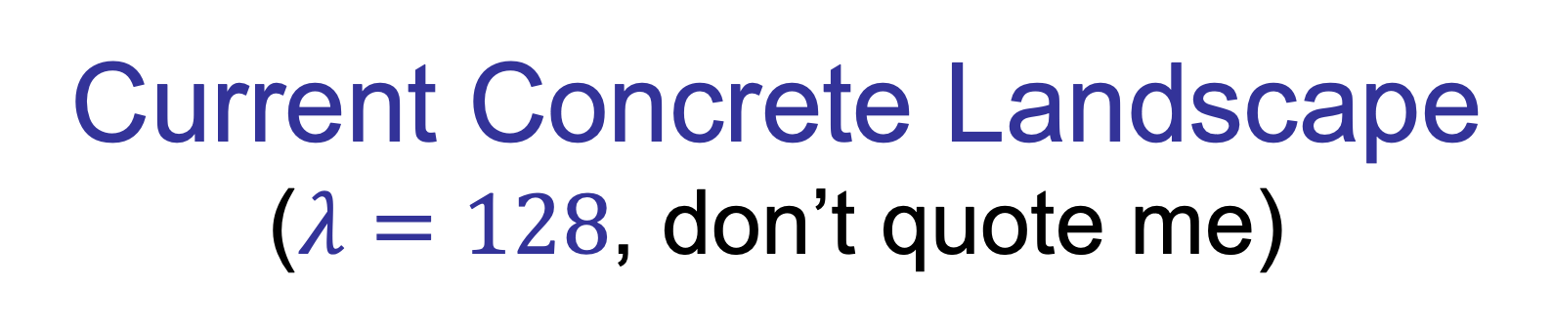
Current Concrete Landscape
($λ=128$, don’t quote me)
1
10
100
1,000
10,000
FHE
Notes:
15

Slide 16
Current Concrete Landscape
PRF
ENC
4
AES
2
Shrinking PRF
(fixed-key) MAC
[FLY22]
10
100
1,000
10,000
1
Can make a difference for MPC applications
* Garbled Circuits
* Pseudorandom Secret Sharing
* Function Secret Sharing
* Pseudorandom Correlation Generators
FHE
Notes:
16
Fang et al.

Slide 17
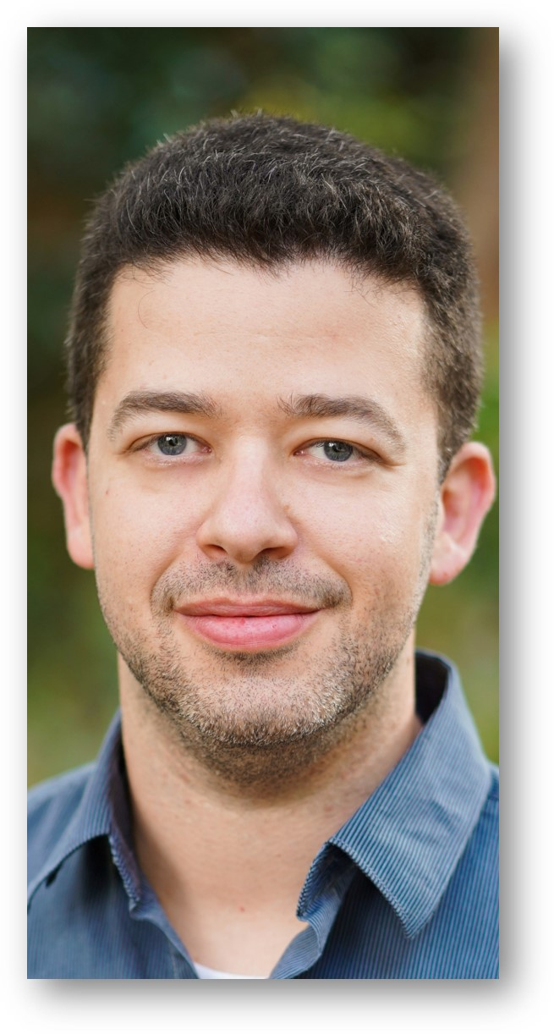
Current Concrete Landscape
Important challenge for proof systems community!
1
10
100
1,000
10,000
CRH?
SHA256
SNARG?
Overhead (seems to be) in the low thousands.
May I quote you?
July 2025
Sure, but with a major disclaimer :)
Notes:
17

Slide 18
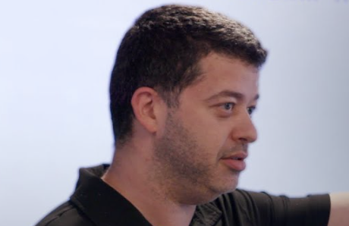
Current Concrete Landscape
Important challenge for proof systems community!
1
10
100
1,000
10,000
CRH?
SHA256
SNARG?
Ballpark 1000
(for “regular” circuits w/100-bit security)
Yesterday
Notes:
18

Slide 19
Current Concrete Landscape
ZK?
malicious 2PC?
1
10
100
1,000
10,000
semi-honest 2PC
[IKOS08,BCGIKRS23]
AMD Circuits
[GIPST14,GIP15,GIW16]
Perfect OT-based 2PC?
[BP19]
malicious OT
[BCGIKRS23]
Notes:
19

Slide 20
Back to Asymptotics…
$λ$ bits of security, under plausible assumptions
1
O(1)
polylog($λ$)
EMVP [BCHIKMRR25]
OWF [Gol00]
FHE, PIR [GHS12,…]
Assuming OT + poly-stretch local PRG
Not even heuristically without local PRG or similar assumptions!
ENC [AIK06,IKOS08]
SNARGs [HR22]
PRF [IKOS08,FLY22]
ZK, mal-2PC [DIK10]
CRH [AHIKV17]
semi-honest-2PC [IKOS08]
mal-OT[BCGIKRS23]
Notes:
20

Slide 21
Step 1: Fast string-OT
- OT of keys + fast encryption
Step 2: Fast 2PC for unbalanced NC⁰
- Information-theoretic garbling + Step 1
Constant locality
Notes:
This goes against the natural tendency to look for complex solutions for complex problems. Here we start with a simple solution and then ask what special cases it solves

Slide 22
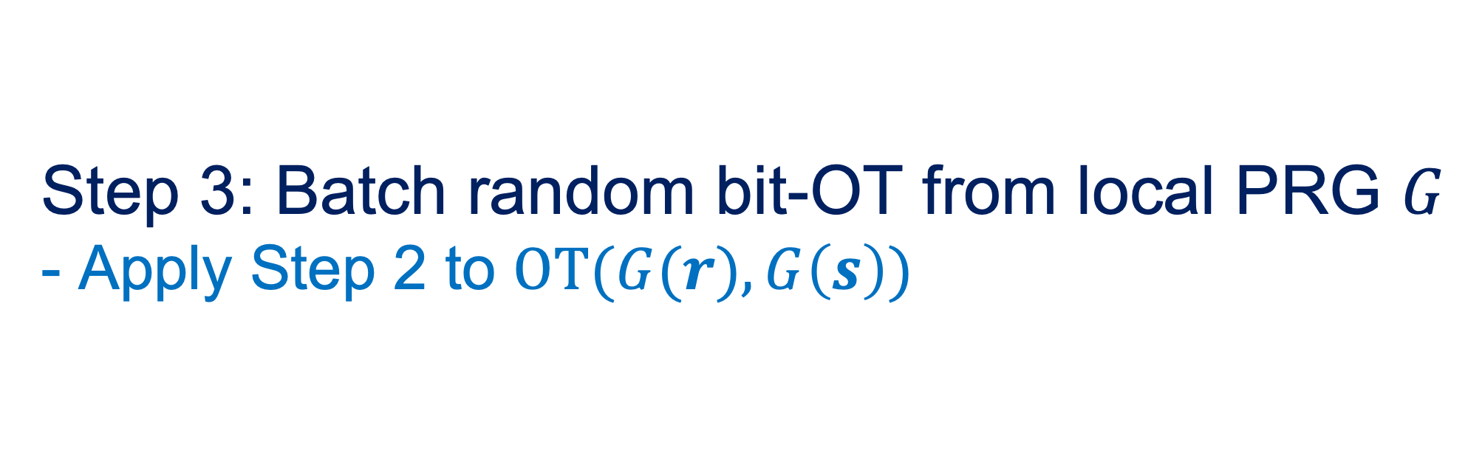
Step 1: Fast string-OT
- OT of keys + fast encryption
Step 2: Fast 2PC for unbalanced NC⁰
- Information-theoretic garbling + Step 1
Step 3: Batch random bit-OT from local PRG $G$
- Apply Step 2 to $OT(G(r),G\left(s\right))$
Final step: GMW / OT
Notes:
This goes against the natural tendency to look for complex solutions for complex problems. Here we start with a simple solution and then ask what special cases it solves. Point out that local PRGs provide the only known route. Optimal-locality of PRG + garbling gives 100x.. Any way to amortize?

Slide 23
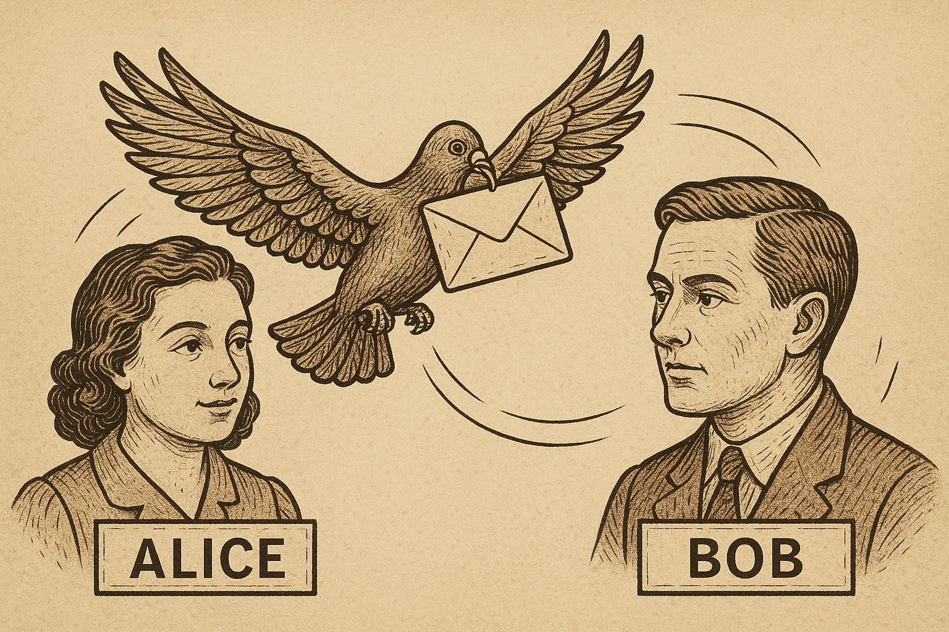
Minimizing Rounds
Notes:
23

Slide 24
Is the “semi-honest” case solved?
Computational
2-round dishonest-majority MPC from OT [Yao86,GS18,BL18]
Non-black-box use of OT necessary [ABGIS20 ]
3-round MPC from black-box OT [PS21]
Only efficient for “simple” functions
Doesn’t cover restricted interaction
Information-Theoretic
2-round honest-majority MPC [BB89, …, ABT18,GIS18]
2-round dishonest-majority MPC from OT correlations [GIS18]
Notes:
24

Slide 25
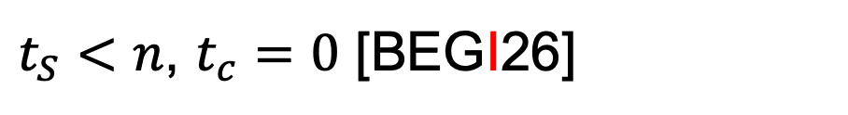
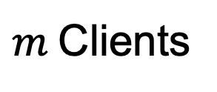
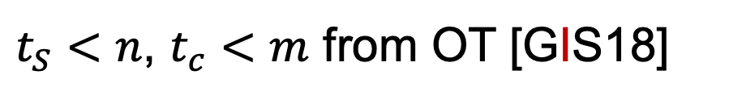
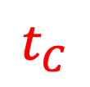


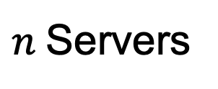
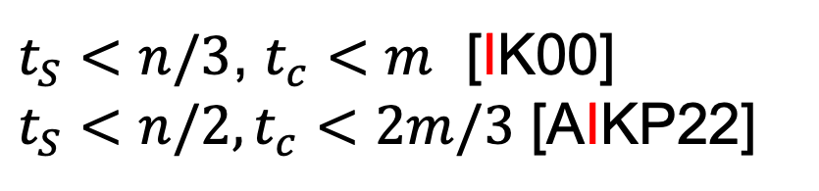
2-Round Client-Server MPC
011
Evaluator
Computational
$t_{S}<n$, $t_{c}<m$ from OT [GIS18]
$t_{S}<n/2$, $t_{c}<m$ ?
$n$Servers
$$t_{S}$$
Information-Theoretic
$t_{S}<n/3$, $t_{c}<m$ [IK00]
$t_{S}<n/2,t_{c}<2m/3$ [AIKP22]
010
110
101
$m$Clients
$$t_{C}$$
$t_{S}<n$, $t_{c}=0$ [BEGI26]

Slide 26

Technical approach
1. Identify a class of easy tasks
2. Reduce a general task to an easy one
Notes:
This goes against the natural tendency to look for complex solutions for complex problems. Here we start with a simple solution and then ask what special cases it solves

Slide 27



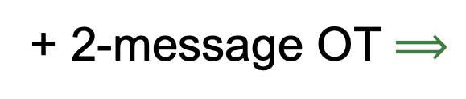

Example Easy functions
2PC with parallel OTs
OT
$$f_{1}f_{2}f_{3}f_{4}f_{5}f_{6}f_{7}f_{8}$$
OT
OT
$$a_{1}a_{2}a_{3}a_{4}a_{5}$$
$$b_{1}b_{2}b_{3}b_{4}b_{5}$$
$$r_{1}r_{2}r_{3}r_{4}$$
+ 2-message OT $⟹$
Alice-locality = 1

Slide 28
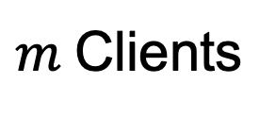
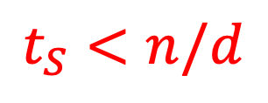
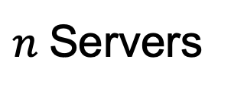
Example Easy functions
Client-server MPC
011
Evaluator
Degree-d polynomials
$n$Servers
$$t_{S}<n/d$$
010
110
101
$m$Clients

Slide 29


Reduction Template:
Randomized Encoding of Functions
x
f
y
x
g
Enc(y)
Enc(y)
r
g is a randomized encoding of f
  Nontrivial relaxation of computing f
  Either information-theoretic or computational
Hope: g can be in the class of “easy tasks”
Notes:
Our key idea is to replace the cryptographic function f with a related function g, taking the original input of f and an additional random input, such that the output of g on input x and a uniformly random r is a randomized encoding of f(x). More specifically, we require that given g(x,r) one can decond f(x), and given f(x) one can simulate the distriution g(x,r) even without knowing x. We refer to g as a randomized encoding of f.
To be useful in our context this type of encoding should be on one hand secure, in the sense that, … and on the other hand liberal enough…
Note that if g is much easier than f, then moving from g to f must be complex.
We now define our notion of randomized encoding in more detail.

Slide 30

Detour: Cryptography in NC⁰
Constant locality
Theorem [AIK04]
Under standard assumptions (e.g., factoring, discrete log, lattices),
most cryptographic primitives can be implemented in NC⁰.
OWF
OWF
Notes:
Our key idea is to replace the cryptographic function f with a related function g, taking the original input of f and an additional random input, such that the output of g on input x and a uniformly random r is a randomized encoding of f(x). More specifically, we require that given g(x,r) one can decond f(x), and given f(x) one can simulate the distriution g(x,r) even without knowing x. We refer to g as a randomized encoding of f.
To be useful in our context this type of encoding should be on one hand secure, in the sense that, … and on the other hand liberal enough…
Note that if g is much easier than f, then moving from g to f must be complex.
We now define our notion of randomized encoding in more detail.

Slide 31
Detour: Cryptography in NC⁰
Theorem [AIK04]
Under standard assumptions (e.g., factoring, discrete log, lattices),
most cryptographic primitives can be implemented in NC⁰.
Not all primitives: PRF, secret-sharing reconstruction, decryption, …
Notes:
Our key idea is to replace the cryptographic function f with a related function g, taking the original input of f and an additional random input, such that the output of g on input x and a uniformly random r is a randomized encoding of f(x). More specifically, we require that given g(x,r) one can decond f(x), and given f(x) one can simulate the distriution g(x,r) even without knowing x. We refer to g as a randomized encoding of f.
To be useful in our context this type of encoding should be on one hand secure, in the sense that, … and on the other hand liberal enough…
Note that if g is much easier than f, then moving from g to f must be complex.
We now define our notion of randomized encoding in more detail.

Slide 32
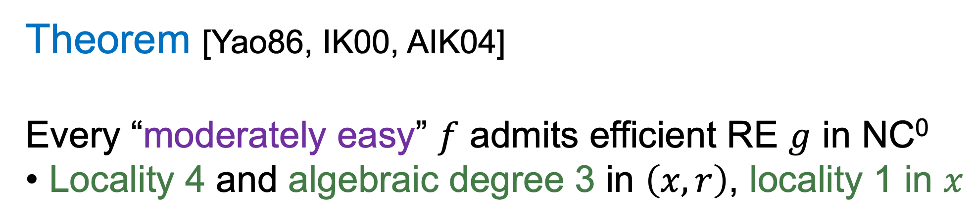
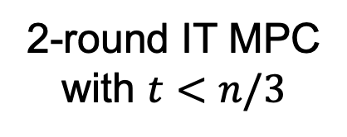
Randomized Encoding Compilers
Theorem [Yao86, IK00, AIK04]
Every “moderately easy” $f$ admits efficient RE $g$ in NC⁰
Locality 4 and algebraic degree 3 in $\left(x,r\right)$, locality 1 in $x$
IT garbling,
2PC w/parallel OT
4-local
cryptography
2-round IT MPC
with $t<n/3$
Still best known in client-server model

Slide 33
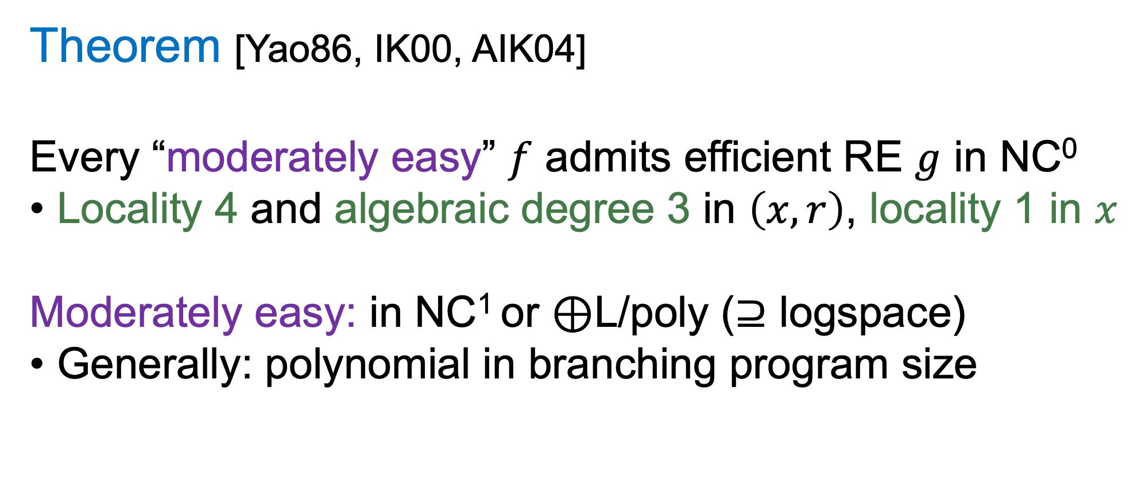
Randomized Encoding Compilers
Theorem [Yao86, IK00, AIK04]
Every “moderately easy” $f$ admits efficient RE $g$ in NC⁰
Locality 4 and algebraic degree 3 in $\left(x,r\right)$, locality 1 in $x$
Moderately easy: in NC¹ or $⊕$L/poly ($⊇$ logspace)
Generally: polynomial in branching program size
Notes:
Our key idea is to replace the cryptographic function f with a related function g, taking the original input of f and an additional random input, such that the output of g on input x and a uniformly random r is a randomized encoding of f(x). More specifically, we require that given g(x,r) one can decond f(x), and given f(x) one can simulate the distriution g(x,r) even without knowing x. We refer to g as a randomized encoding of f.
To be useful in our context this type of encoding should be on one hand secure, in the sense that, … and on the other hand liberal enough…
Note that if g is much easier than f, then moving from g to f must be complex.
We now define our notion of randomized encoding in more detail.

Slide 34


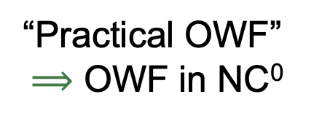
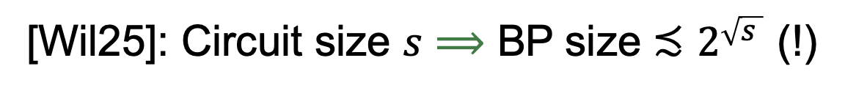
Randomized Encoding Compilers
[Yao86, AIK05]: Similar conclusion for all polynomial-time $f$, but:
Computationally secure RE
Assuming moderately easy OWF
Theorem [Yao86, IK00, AIK04]
Every “moderately easy” $f$ admits efficient RE $g$ in NC⁰
Locality 4 and algebraic degree 3 in $\left(x,r\right)$, locality 1 in $x$
Moderately easy: in NC¹ or $⊕$L/poly ($⊇$ logspace)
Generally: polynomial in branching program size
[Wil25]: Circuit size $s$ $⟹$ BP size ${≾2}^{\sqrt{s }}$ (!)
“Practical OWF”
$⟹$ OWF in NC⁰
Notes:
Practical = subquadratic circuit size and close to full security

Slide 35
Open Questions: Randomized Encodings
Randomized encoding
Low-complexity cryptography
MPC
    poly-size NC⁰ encoding for every f∈P?
    Efficient constant-round IT-MPC for every f∈P?
    OWF ➔
    OWF in NC⁰?
    degree 2 for every f?
    Optimal client-server
    MPC?
    OWF in NC¹➔
    3-local OWF?
    better
    constant-round protocols?
    better encodings?
    faster
    hardware?

Slide 36
Breaking the Degree-3 Barrier
[ABT18]
011
Evaluator
Idea:
Take advantage of local preprocessing!
010
110
101

Slide 37
Breaking the Degree-3 Barrier
[ABT18]
011
Evaluator
Degree 2?
Needed to resist Evaluator + Clients
Alternatively: Additive RE
[HIKR23]
010
110
101

Slide 38
Simple Degree-2 MPRE
[AIKP22]
011
Evaluator
Locally guess transcript for
honest-majority MPC
Consistency check admits
degree-2 RE
010
110
101

Slide 39
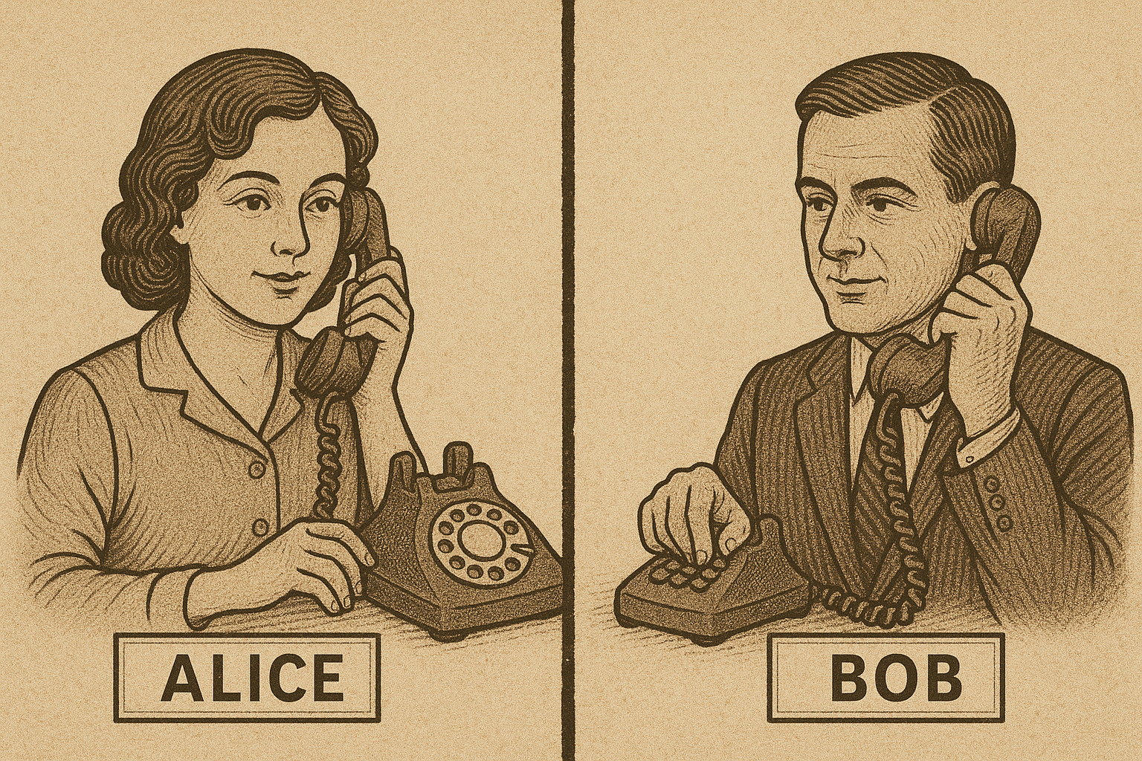
Minimizing Communication
Notes:
39

Slide 40

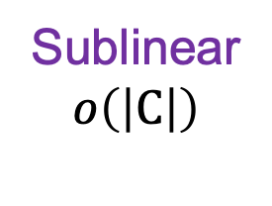
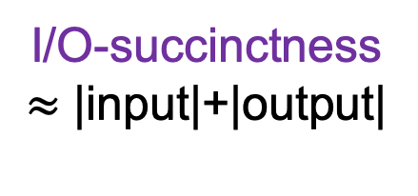
Levels of Succinctness
Information-theoretic variant?
* Related to IT-PIR [CGKS95] and LDC [KT00]
* Improvement for “worst-case” functions [BIKK14]
Sublinear
$$o\left(\left|C\right|\right)$$
I/O-succinctness
$≈$ |input|+|output|
Full succinctness
$≈$ insecure communication
HSS
HSS
FHE
Lattices / Groups* / LPN*
Lattices / Groups**
Lattices
*For “typical” circuits
**For branching programs
Notes:
40

Slide 41

Levels of Succinctness
Sublinear
$$o\left(\left|C\right|\right)$$
I/O-succinctness
$≈$ |input|+|output|
Full succinctness
$≈$ insecure communication
HSS
HSS
FHE
Lattices / Groups* / LPN*
Lattices / Groups**
Lattices
**For branching programs
Notes:
41

Slide 42
Levels of Succinctness
Sublinear
$$o\left(\left|C\right|\right)$$
I/O-succinctness
$≈$ |input|+|output|
Full succinctness
$≈$ insecure communication
HSS
HSS
FHE
Lattices / Groups* / LPN*
Lattices / Groups**
Lattices
Can we break the circuit size barrier at a low computational cost?
Even in the honest-majority setting?
Notes:
42

Slide 43
Tool: Pseudorandom Correlation Generators
[BCGI18, BCGIKS19, …]
Gen
Many instances of
a target correlation
k₀
k₁
Expand (k₀)
Expand(k₁)
Typical PCG constructions: practical for simple correlations
Support secure computation of simple gates
Notes:
Even we we are just 10x better in communication, this can be a game-changer.

Slide 44
PCGs for Unit-Vector Correlations
[ABGIKM24]
Gen
Many instances of
random shared unit vectors
k₀
k₁
Expand (k₀)
Expand(k₁)
Compressing
many
one-time TT
Sublinear MPC
for “typical”
circuits
PCG
for UV
Notes:
Even we we are just 10x better in communication, this can be a game-changer.

Slide 45
PCGs for Unit-Vector Correlations
[ABGIKM24]
Gen
Many instances of
random shared unit vectors
k₀
k₁
Expand (k₀)
Expand(k₁)
New symmetric primitive
sparse pseudorandom output
Compressing
many
one-time TT
Sublinear MPC
for “typical”
circuits
PCG
for UV
Sparse PRG
structured seed
Notes:
Even we we are just 10x better in communication, this can be a game-changer.

Slide 46
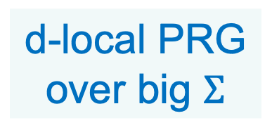
PCGs for Unit-Vector Correlations
[ABGIKM24]
Gen
Write each PRG seed symbol and output symbol as unit vector
Many instances of
random shared unit vectors
k₀
k₁
Expand (k₀)
Expand(k₁)
Compressing
many
one-time TT
Sublinear MPC
for “typical”
circuits
d-local PRG
over big $Σ$
d-degree
sparse PRG
PCG
for UV
+ HSS for d-degree
polynomials
(“for free” if n>dt)
Notes:
Even we we are just 10x better in communication, this can be a game-changer.

Slide 47
Local PRGs Over Nonbinary Alphabets
First considered for obfuscation
  2-local PRG with poly-stretch ➔ iO from pairings [LT17]
  Essentially ruled out in [BBKK17,LV17]
Implied by binary local PRGs via concatenation
  But minimal locality is 5 for polynomial stretch
Simple 3-local candidate via non-Abelian groups [BBKK17]
New candidates [ABGIKM24]
  Variant of sparse Learning With Rounding
  Goldreich-style construction
Notes:
Even we we are just 10x better in communication, this can be a game-changer.

Slide 48
Conclusion
Still a long way to go
  Even in simple models for secure computation
Motivates other complexity questions
  Randomized encodings
  Low-complexity symmetric cryptography, sparse PRGs, …
Major challenges
  Malicious security with constant overhead?
    Improve concrete overhead or assumptions for semi-honest
  Efficient constant-round information-theoretic MPC?
  Practical sublinear communication

